Slide 1
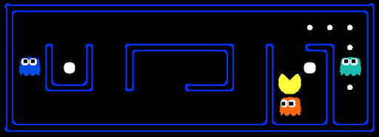
IS RL AS GOOD AS WE THINK IT IS? ADVERSARIAL ATTACK ON REINFORCEMENT LEARNING ALGORITHM
Submitted by:
Mithun Bharadwaj
114931115

Slide 2
PROBLEM STATEMENT
GOALS:
Examine the robustness of policies learned through reinforcement learning.
Generate adversarial examples to trick the policy into taking a different action than what it normally would.
Verify that adding random noise does not cause the same effect.
Train an agent using Deep Q-Learning
Generate adversarial example using FGSM
Check how it affects the policy

Slide 3
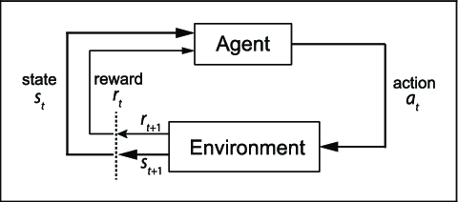
REINFORCEMENT LEARNING
Reinforcement learning (RL) is one of three basic machine learning paradigms, alongside supervised learning and unsupervised learning.
RL is concerned with how software agents ought to take actions in an environment in order to maximize the expected cumulative reward
RL relies on the agent’s interaction with the environment to learn the optimal behavior for the task.

Slide 4
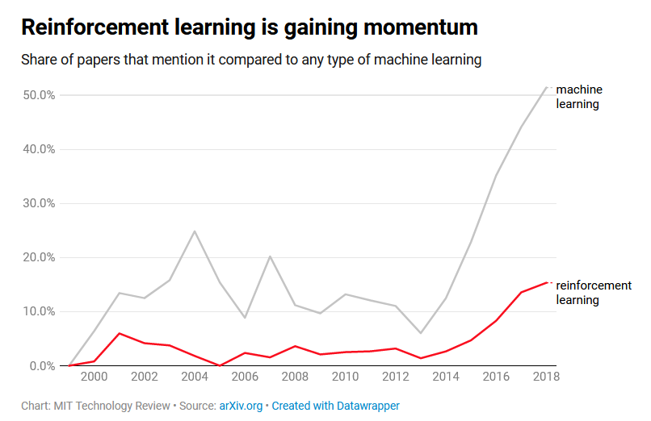
RISE IN POPULARITY OF RL
According to MIT Technology Review, Reinforcement Learning has been gaining popularity in the recent years .
We need to be careful in where we deploy these models and pay attention to their robustness.

Slide 5
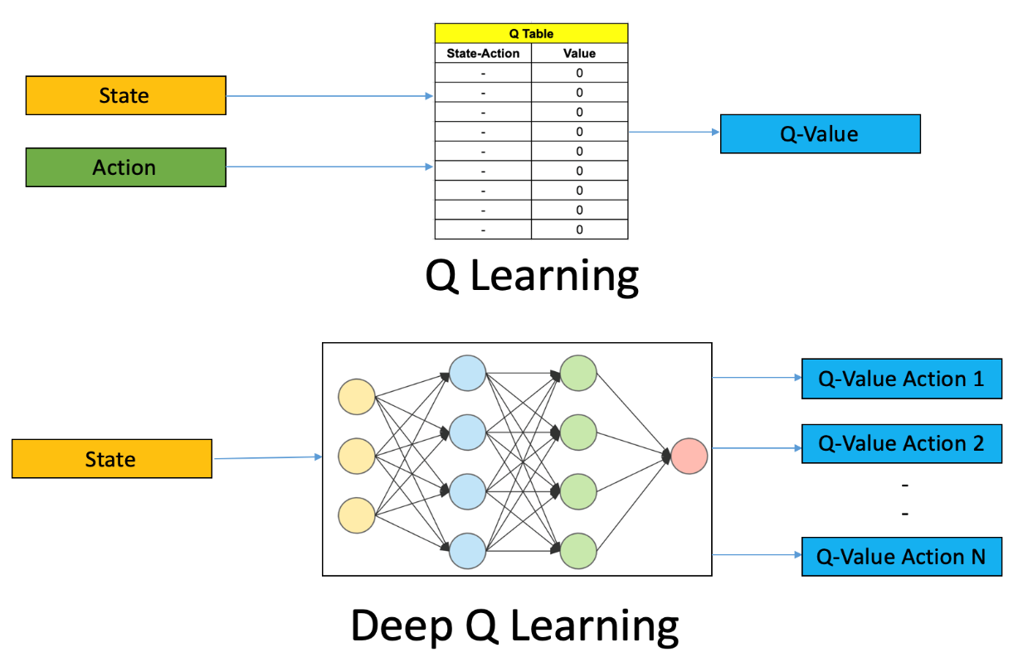
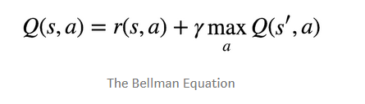
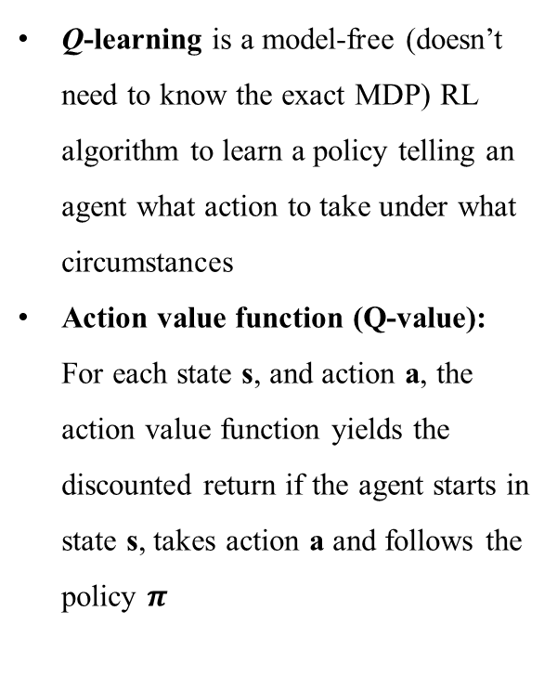
Q-LEARNING
Q-learning is a model-free (doesn’t need to know the exact MDP) RL algorithm to learn a policy telling an agent what action to take under what circumstances
Action value function (Q-value): For each state s, and action a, the action value function yields the discounted return if the agent starts in state s, takes action a and follows the policy $π$

Slide 6
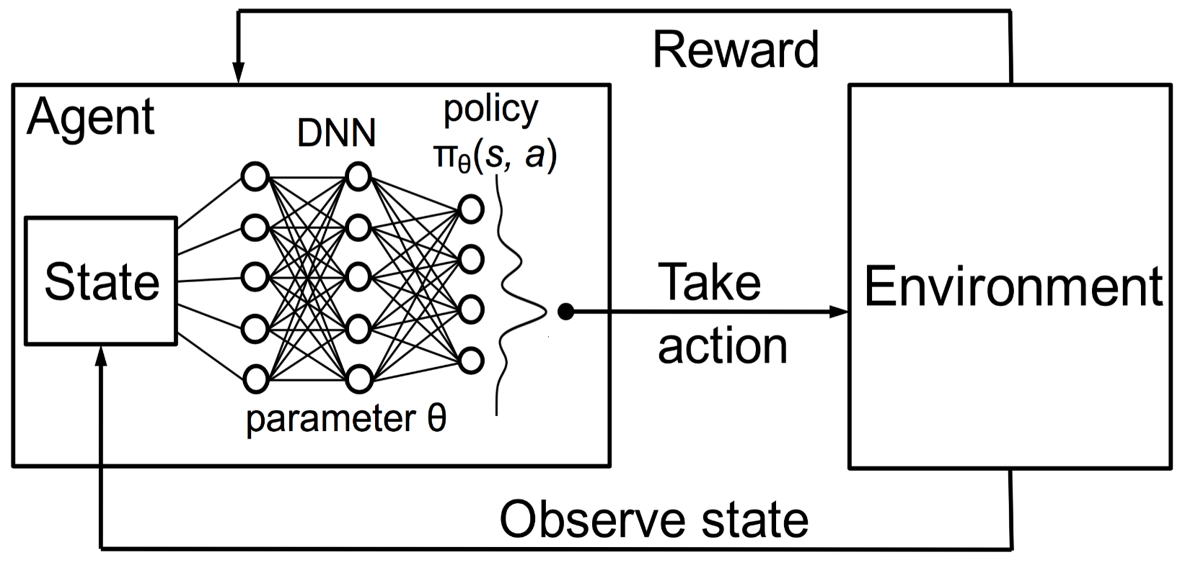
DEEP Q-LEARNING
As the number of valid states increases, the calculation of Q values become extremely difficult and intensive.
Using Neural Networks to estimate the Q-value in such cases is the Seep Q-Learning algorithm.
The network is usually referred to as the approximator or the approximating function.

Slide 7
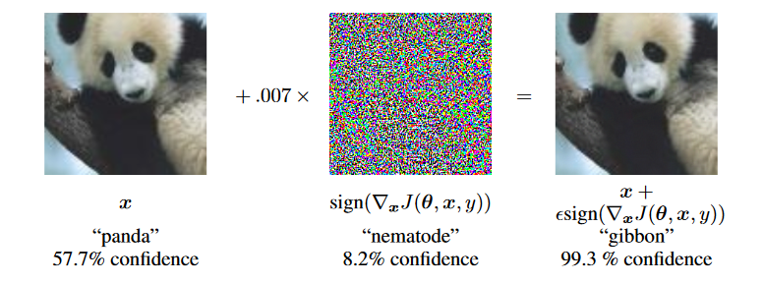
ADVERSARIAL EXAMPLE
Adversarial examples are inputs to machine learning models that have been intentionally optimized to cause the model to make a mistake.
White box vs Black box : In the white box scenario, the adversary has full knowledge of the model including model type, model architecture and values of all parameters and trainable weights.

Slide 8
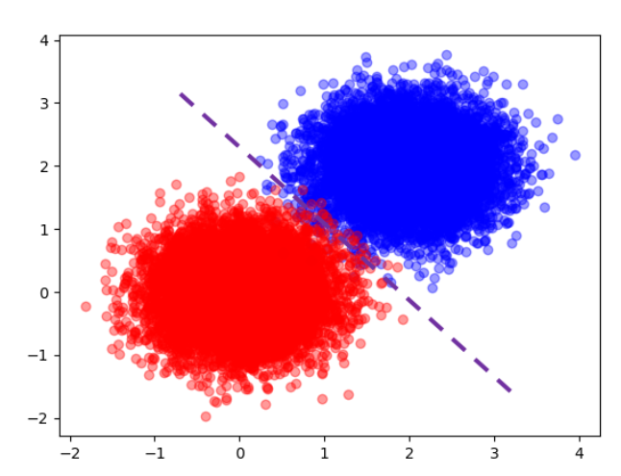
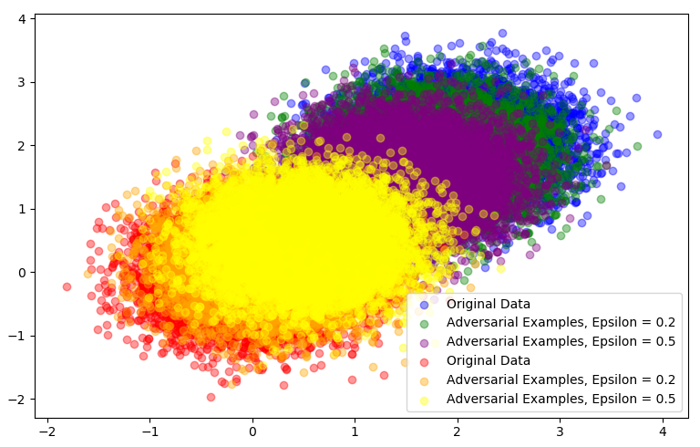
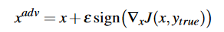
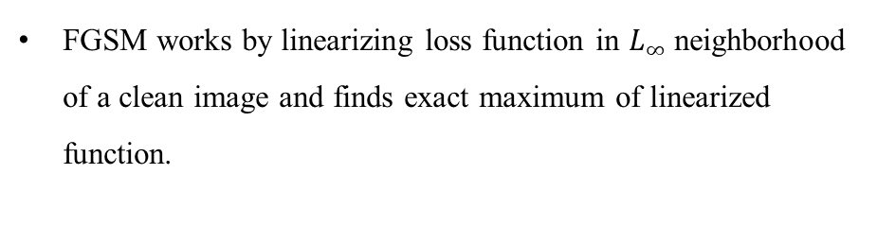
FAST GRADIENT SIGN METHOD (FGSM)
FGSM works by linearizing loss function in $L_{∞}$ neighborhood of a clean image and finds exact maximum of linearized function.

Slide 9
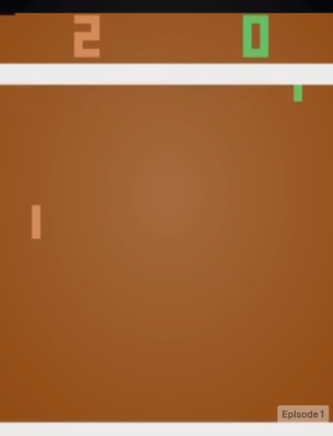
ENVIRONMENT (PONG)
The environment is based on the Atari 2600 game Pong.
In this environment, the observation (state) is an RGB image of the screen which is an array of shape (210, 160, 3).
Objective:
Game ends at a score of 21
Make the green player reach a score of 21 as early as possible

Slide 10
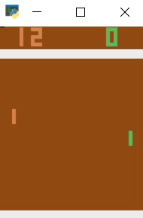
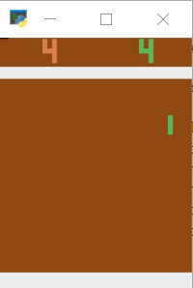
TRAINED MODEL
Trained for 400 episodes on Google Colab

Slide 11
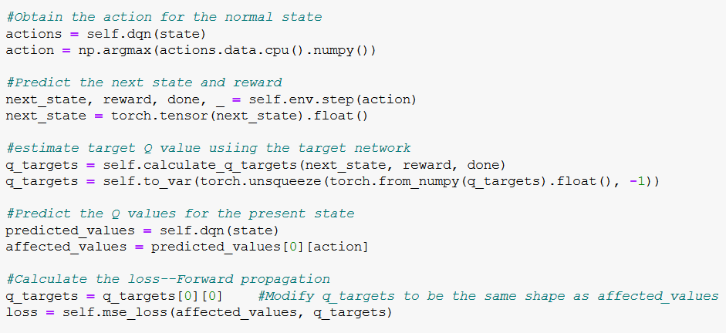
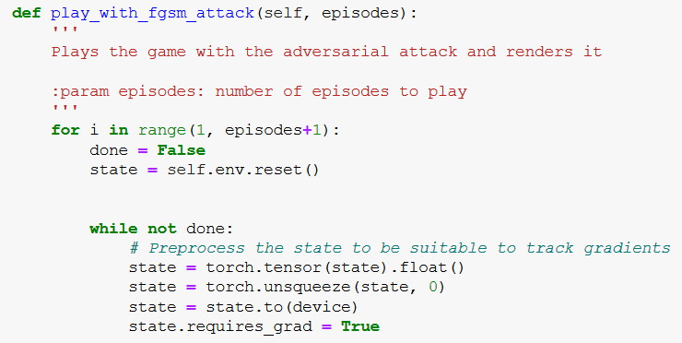
FGSM IMPLEMENTATION (FORWARD PROP)
PREPROCESS STATE
FORWARD PROP

Slide 12
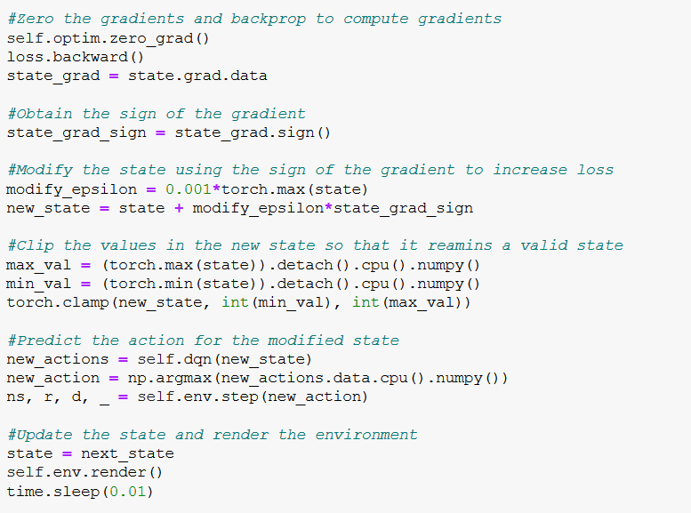
FGSM IMPLEMENTATION (BACK PROP)
GitHub link to the project repository*:
https://github.com/mithun-bharadwaj/RL_Final_Project
* Copy paste the link into the browser. For some reason I’m not able to open it through hyperlink

Slide 13

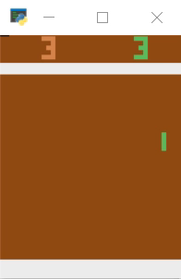
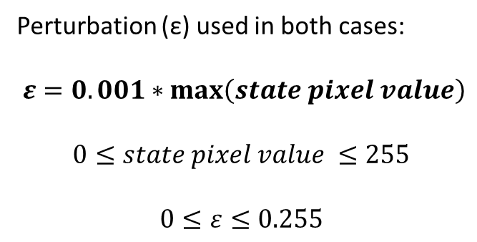
RESULTS
Perturbation (ε) used in both cases:
$ε=0.001∗\max\left(state pixel value\right)$
$$0≤state pixel value ≤255$$
$$0≤ε≤0.255$$
FGSM ATTACK
RANDOM NOISE

Slide 14
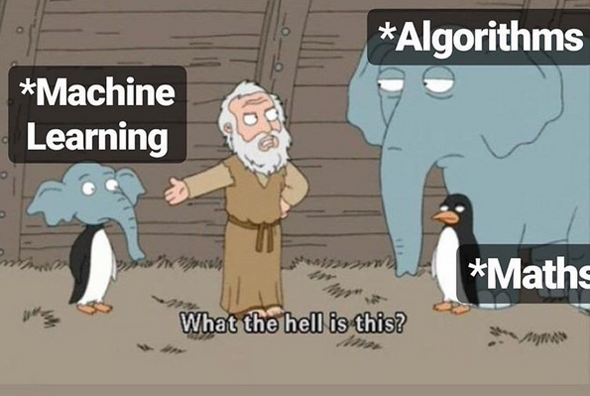
CONCLUSION
Although Machine Learning has taken off like wildfire, and has been used successfully in many major applications, we should always keep the robustness of the model policy in mind.
As we have seen, the policy can be corrupted with a small but calculated amount of noise that barely has a visual impact on the input.

Slide 15
FUTURE WORK
Check the vulnerabilities of the policy to other type of attacks.
Make the policy more robust to such perturbations by defending these attacks.
Certifiable robustness where we can assure if the state is perturbed by certain amount, it won’t have any impact on the policy.
All of these involve in-depth understanding of the models, what’s happening under the hood and how the model arrives at the decision boundary.

Slide 16
THANK YOU!!
QUESTIONS??

